Slide 1

Mini Project-I (K24MCA18P) Odd Semester Session 2024-25
Your Notes / Precious Notes
Team Leader : Vikas Singh & University Roll Number : 2426mca317
Project Supervisor:
Supervisor Name
Designation

Slide 2
Content
Introduction (1 slide)
Literature Review (2 slides)
Objective of the Project (1 slide)
Technology
Hardware Requirements (Development Environment, Server requirement (if required), Client requirement (if required).
Software Requirements (Language and Platforms like Frameworks, VS code, Android Studio and Jupyter notebook etc. )
Modules (2-3 slides)
Workflow (1 slide)
Reports (For Example: Project : Student Monitoring System, so reports like: Student Marks, Subjects, companies visit, and student appears in placement etc.)
References (1 slide)
Notes:
Font Styles: Times New Roman + Font Size: 25

Slide 3
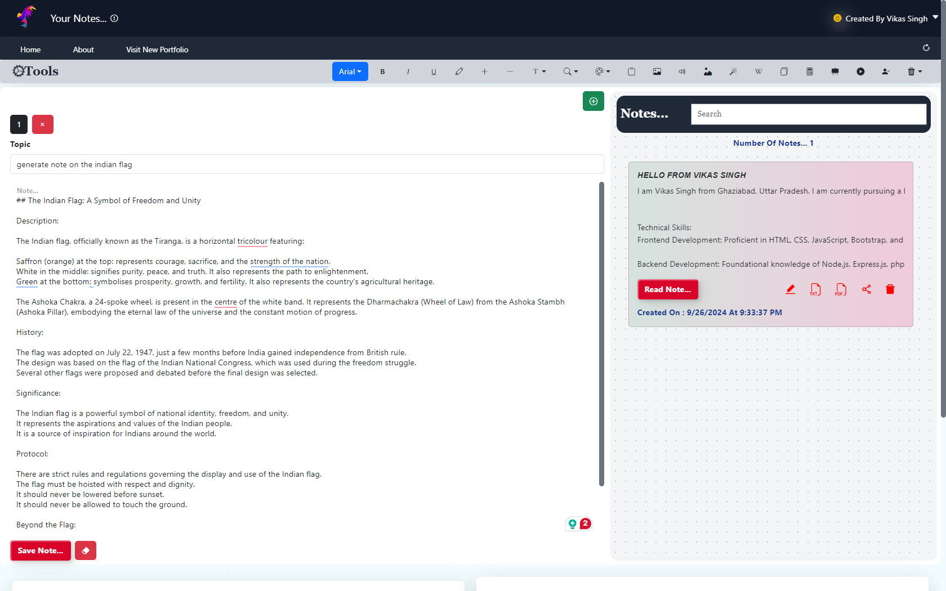
Introduction
Introduction to Precious Notes / Your Notes
Precious Notes is a revolutionary AI-powered note-taking and image generation application designed for modern users who need more than just a basic note-taking tool. It securely stores all data in the user’s local storage with encryption, ensuring privacy while offering powerful features that enhance productivity and creativity.
With Precious Notes, users can create and organize notes effortlessly. The app provides advanced capabilities, such as generating AI-powered notes and images, uploading and annotating images, and using a built-in drawing tool to create and download diagrams. Additionally, it includes a full suite of text formatting and designing tools, allowing users to customize their notes with ease.
This AI-driven solution is perfect for those who value security and flexibility, making it ideal for professionals, students, and creatives. By combining note-taking, design, and AI capabilities, Precious Notes empowers users to manage and visualize their ideas like never before.
Notes:
Font Styles: Times New Roman + Font Size: 25

Slide 4
Literature Review
Evolution of Note-Taking Apps
Traditional note-taking apps like Evernote and OneNote focus on cloud storage and basic features. However, growing concerns over data privacy and security are pushing users towards more secure and modern note-taking solutions.
AI in Note-Taking
Apps like Notion and Roam Research use AI to help users organize content automatically. Precious Notes takes it further by generating both AI-powered notes and AI-generated images, making it a unique tool for productivity and creativity.
Local Storage and Privacy
Privacy is becoming increasingly important. Apps like Obsidian store data locally instead of in the cloud. Precious Notes ensures user privacy by storing everything securely in local storage with encryption, so no one, not even the developer, can access the notes.
Advanced Features
Most apps provide simple text and drawing options. Precious Notes offers text formatting, a drawing tool to create and download diagrams, as well as the ability to upload and write on images, making it a versatile and powerful tool.
Notes:
Font Styles: Times New Roman + Font Size: 25

Slide 5
Literature Review (Contd.)
AI-Based Image Generation
AI image generation is a rising trend, with platforms like DALL·E leading the way. These tools allow users to create images from text, unlocking new possibilities for creativity. Precious Notes incorporates this technology, giving users the power to generate images using AI alongside their notes, making it ideal for visual learners and creatives.
Enhanced User Experience
Modern note-taking tools are expected to provide more than just basic note-taking functionality. Precious Notes elevates the user experience with advanced text formatting, designing tools, and easy organization within local storage. This all-in-one approach makes the app versatile and user-friendly, catering to diverse needs, from simple to-do lists to advanced diagram creation.
Conclusion
Precious Notes sets itself apart by combining the latest in AI technology with strong privacy features and a focus on ease of use. By offering AI-generated content, local encryption, and versatile formatting tools, it is positioned as an innovative solution in the evolving landscape of note-taking applications.
Notes:
Font Styles: Times New Roman + Font Size: 25

Slide 6
Objective of the Project
The Precious Notes project aims to revolutionize the way users take and manage notes by combining advanced AI technology with secure, local data storage. Its primary goal is to offer a modern, AI-based platform where users can create, organize, and store notes, images, and diagrams, all while maintaining full control over their data through encryption.
In alignment with the United Nations Sustainable Development Goal (SDG) 4: Quality Education, Precious Notes supports learners by offering an innovative, user-friendly tool that fosters personalized and flexible learning. The AI-powered note and image generation features allow users to quickly capture ideas, generate content, and visually represent concepts, enhancing comprehension and creativity. These features promote self-directed learning, making it easier for students, educators, and professionals to manage information and study materials effectively.
By integrating tools for text formatting, diagram creation, and AI-based content generation, Precious Notes supports diverse learning styles and facilitates a more inclusive educational experience. Whether used in formal education or personal development, the app encourages efficient note management, leading to better learning outcomes and contributing to the broader mission of providing inclusive and equitable quality education for all.
Notes:
Font Styles: Times New Roman + Font Size: 25

Slide 7
Technology (Hardware Requirements)
Hardware Requirements
Processor: A dual-core processor or higher to handle the demands of running the application smoothly.
RAM: At least 4GB of RAM for optimal performance, particularly when generating images or handling multiple notes.
Storage: Sufficient local storage for users to save their notes, images, and application data securely.
Server-Side (if applicable for any backend services):
Processor: Quad-core processor to efficiently handle incoming requests and manage application logic.
RAM: Minimum of 8GB for smooth server operation and to support concurrent users.
Storage: SSD storage for faster data retrieval and application performance.
Server Requirements
While Precious Notes primarily operates on a client-side architecture with local storage, if any server-side functionality is introduced (e.g., for user authentication or cloud backup), the following requirements would be ideal:
Web Server: Apache or Nginx for hosting the backend service.
Node.js: Installed on the server to run the Express.js framework.
Database (if required): A lightweight database like SQLite or MongoDB can be used for any additional features that may require server-side data handling.
Client Requirements
To use Precious Notes, users will need:
A modern web browser (Chrome, Firefox, Safari, or Edge) to access the application.
An internet connection for initial setup and to utilize AI generation features (if applicable).
Compatible operating system: Windows, macOS, or Linux, as the app is designed to be cross-platform.
Notes:
Font Styles: Times New Roman + Font Size: 25

Slide 8
Technology (Software Requirements)
Software Requirements
Frontend Technologies:
React.js: A JavaScript library for building user interfaces, allowing for a dynamic and responsive user experience.
HTML/CSS: For structuring and styling the application, ensuring a clean and modern design.
Tailwind CSS: A utility-first CSS framework used for rapid UI development, providing customizable design elements.
Framer Motion: A library for animations in React, enhancing user interactions with smooth transitions.
Backend Technologies:
Node.js: A JavaScript runtime environment used for server-side development, enabling the creation of a robust backend to support application logic.
Express.js: A web application framework for Node.js, facilitating the development of APIs and server-side logic.
Database:
Local Storage: Data is securely stored in the user's local storage using encryption, ensuring privacy and security without relying on a central database.
AI Technologies:
OpenAI API or Similar: Utilized for generating AI-driven content and images, allowing users to create notes and visual content efficiently.
Notes:
Font Styles: Times New Roman + Font Size: 25

Slide 9
Modules
Modules Used in Precious Notes App
Frontend Modules
React.js: The core library for building the user interface, enabling component-based architecture and dynamic rendering.
React Router: Used for routing and navigation between different pages and components within the app.
Axios or Fetch API: For making HTTP requests to any APIs if required (e.g., for AI content generation).
Framer Motion: For adding animations and transitions to enhance user interactions and provide a smooth experience.
Tailwind CSS: A utility-first CSS framework that allows for rapid UI development with customizable components.
React Icons: A library for incorporating various icons into the UI, improving visual aesthetics and usability.
Backend Modules (if applicable)
Node.js: The JavaScript runtime environment used for building the backend of the application.
Express.js: A web application framework for Node.js that simplifies API creation and request handling.
CORS: Middleware for enabling Cross-Origin Resource Sharing, allowing the frontend to communicate with the backend safely.
dotenv: A zero-dependency module that loads environment variables from a .env file, ensuring secure handling of sensitive information.
Notes:
Font Styles: Times New Roman + Font Size: 25

Slide 10
Modules
AI Modules
OpenAI API or Similar: Integration for AI-driven content and image generation, allowing users to create notes and images through natural language prompts.
TensorFlow.js If any custom AI models are used, this library allows you to run machine learning models directly in the browser.
Data Storage Modules
LocalStorage API: For securely storing notes, images, and user data directly in the user's browser, ensuring data privacy and accessibility.
Drawing Module
Fabric.js: A powerful and simple JavaScript library for working with HTML5 canvas, used for creating the drawing tool feature.
Konva.js: An alternative library for 2D drawing, enabling users to create, manipulate, and export drawings.
Testing Modules (alpha testing)
React Testing Library: For testing React components, ensuring they render and behave correctly.
Notes:
Font Styles: Times New Roman + Font Size: 25

Slide 11
Modules (Contd.)
Deployment Modules
Vercel, or Netlify: Platforms for deploying the app, allowing for easy hosting and continuous integration.
Git: Version control system used for managing code changes and collaboration during development.
Additional Libraries
Lodash: A utility library that provides helpful functions for data manipulation and management.
Moment.js or date-fns: For date manipulation and formatting, if the app includes any time-related features.
Notes:
Font Styles: Times New Roman + Font Size: 25

Slide 12
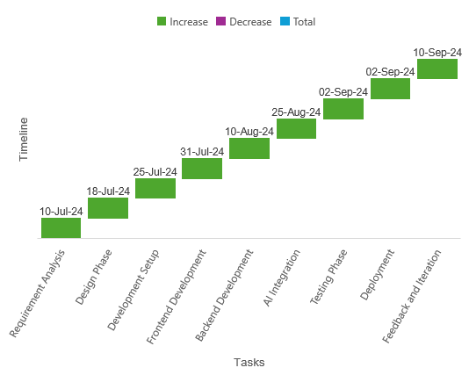
Workflow/Gantt Chart
Workflow Overview
Requirement Analysis: Gather and document user requirements and project scope.
Design Phase: Create wireframes and UI designs to define the look and feel of the app.
Development Setup: Set up the development environment and necessary tools.
Frontend Development: Implement the user interface and client-side logic using React and Tailwind CSS.
Backend Development: Develop the server-side logic using Node.js and Express.js, integrating any required APIs.
AI Integration: Incorporate AI functionalities for note and image generation.
Testing Phase: Conduct thorough testing, including unit tests and user acceptance testing.
Deployment: Deploy the application on platforms like Netlify for public access.
Feedback and Iteration: Collect user feedback and iterate on the design and functionality for improvements.
Notes:
Font Styles: Times New Roman + Font Size: 25

Slide 13
Reports
Notes Created
Total Notes: Shows the total number of notes created by users.
AI-Generated Notes: Number of notes created with AI assistance.
Manual Notes: Number of notes manually created by users without AI help.
Images Generated
Total Images: Total number of AI-generated images linked with notes.
Images per User: Average number of images created by users.
Uploaded Images: Images uploaded by users and attached to their notes.
Drawing and Diagrams
Total Drawings: Number of drawings created using the drawing tool.
Diagrams Downloaded: How many diagrams users have created and downloaded.
User Engagement: Frequency of users utilizing the drawing tool.
Text Formatting Usage
Formatting Tools Used: Report on the usage of text formatting tools (bold, italics, colors, etc.).
Most Popular Features: Identify the most-used text formatting options.
Design Features: Report on user interaction with note design tools.
Notes:
Font Styles: Times New Roman + Font Size: 25

Slide 14
Reports
User Activity
Active Users: Number of users actively creating or editing notes.
Inactive Users: Users registered but not actively using the app.
Usage Duration: Average time users spend on the app per session.
Storage and Local Data
Local Storage Utilization: Amount of data stored locally per user.
Encryption Status: Status of encrypted data in local storage.
Notes Backup: Reports on whether users export or back up their notes.
Feedback and Feature Requests
User Feedback Collected: Feedback submitted by users on app performance.
Feature Requests: New features requested by users to improve the app.
Notes:
Font Styles: Times New Roman + Font Size: 25

Slide 15
References
YouTube Channels
Pyush Garg - Offers tutorials on web development and practical coding skills, providing insights into modern development practices.
Harkerat - Focuses on coding tutorials, particularly in JavaScript and React, which can help enhance the frontend development of the app.
Step by Step - Provides clear, structured tutorials on various programming concepts, making it easier to understand complex topics.
Code with Harry - A comprehensive channel for learning programming languages and frameworks, useful for gaining coding expertise.
GitHub Repositories
Iamvikassingh - A repository showcasing personal projects, including note-taking applications, providing inspiration for design and functionality.
Thomas.dev - Contains various coding projects and modules that can be referenced for features and best practices in note-taking applications.
Self-Ideas and Observations
Drawing from personal experiences and user needs to create a more efficient and user-friendly note-taking app.
Observing the limitations of traditional note-taking apps and aiming to solve these real-life problems with innovative features.
Modules from Other Applications
Incorporating features from existing note-taking applications such as:
Evernote: for organization and tagging of notes.
Notion: for collaborative features and databases.
Google Keep: for simplicity and ease of use in creating quick notes.
Notes:
Font Styles: Times New Roman + Font Size: 25

